Slide 1
2024 GRAND LIST Assessor Stuart Topliff

Slide 2
2024 Grand List Change
2024 % of GL
Real Estate 2,508,387,675 87.14%
Personal Property 183,349,740 6.33%
Motor Vehicles 203,993,679 7.03%
Net Grand List 2,895,731,094 100%

Slide 3
2024 Grand List Change
2023 2024 Change %
Real Estate 2,523,267,660 2,508,387,675 -14,879,985 -.59%
Personal Property 181,630,310 183,349,740 1,719,430 .95%
Motor Vehicles 230,977,044 203,993,679 -23,682,251 -11.68%
Net Grand List 2,935,875,014 2,895,731,094 -40,143,920 -1.26%

Slide 4
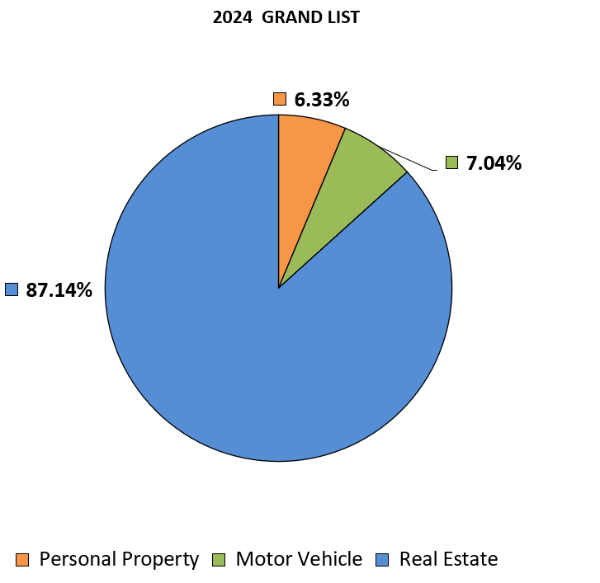
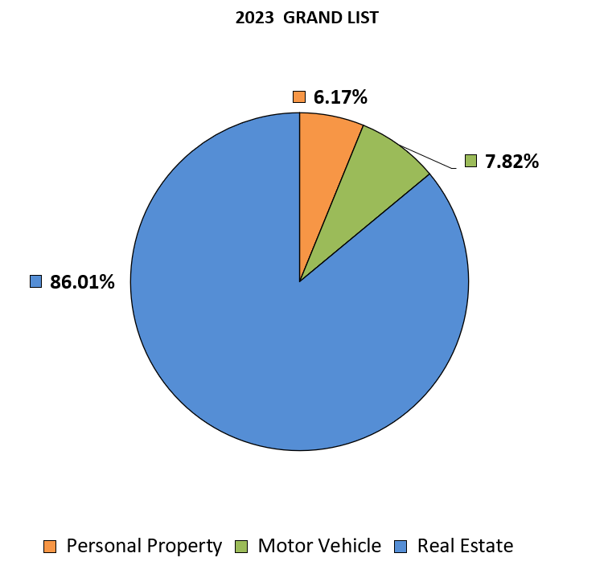

Slide 5
Impacts to the 2024 Grand List
Public Act 24-46:
Created CGS 12-81 (83)
CGS 12-81 (83) Exempted the primary dwelling or 1 motor vehicle for veterans who are permanently and totally disabled.
Rocky Hill has 18 veterans who qualified for 12-81 (83) with a total assessment of 3,496,500 or $101,993.

Slide 6
Impacts to the 2024 Grand List
Public Act 24-1 (SS) changed CGS 12-63 and how motor vehicles are valued and created CGS 12-81 (82).
Previously motor vehicles were valued using clean retail in JD Powers pricing guides.
Now Vehicles are valued using the MSRP less depreciation using Price Digest pricing guides and created a minimum assessment of $500 on motor vehicles.
CGS 12-81 (82) exempts snowmobiles, all-terrain vehicles and residential utility trailers used exclusively for personal use.

Slide 7
Impacts to the 2024 Grand List
Average Assessment of a Motor Vehicle:
2023 2024 $ Change % Change Savings @ 29.17
Passenger Car 12,600 11,500 -1,100 -8.73% $32.09
Commercial 32,300 29,900 -2,400 -7.43% $70.00
Pickup Truck 16,115 12,600 -3,515 -21.81% $102.53
All Others 7,100 4,800 -2,300 -32.39% $67.09

Slide 8
Top Ten Taxpayers
Owner Location Assessment
1. Century Hills Property Owner LLC (Concierge) 98 Cold Spring Road 54,862,080
2. RP Glenbrook LLC (Glenbrook) 100 Century Hills Drive 39,818,170
3. BJS Wholesale Club INC 490 Brook Street 35,549,360
4. Sysco Food Service of CT LLC 100 Inwood Road 30,122,960
5. Connecticut Light and Power (Eversource) Various 29,946,000
6. Churchill Property Portfolio 50 Cold Spring Road 29,433,600
7. MKS 500 Enterprise LLC 500 Enterprise Drive 27,650,000
8. Connecticut Natural Gas 1376 Cromwell Avenue 35,073,610
9. Rocky Hill Properties LLC (Alterra) 647 Brook Street 22,050,000
10. West Street Developers LLC (Montage) 900 West Street 22,050,000

